Slide 1

Detailed overview of COVID-19 for Uttarpradeshiew of COVID 19
Minor project 1
Submitted by : jahnvi jain

Slide 2
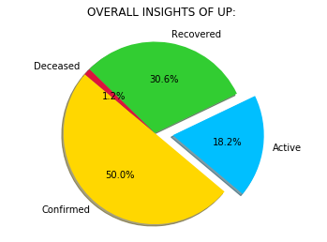
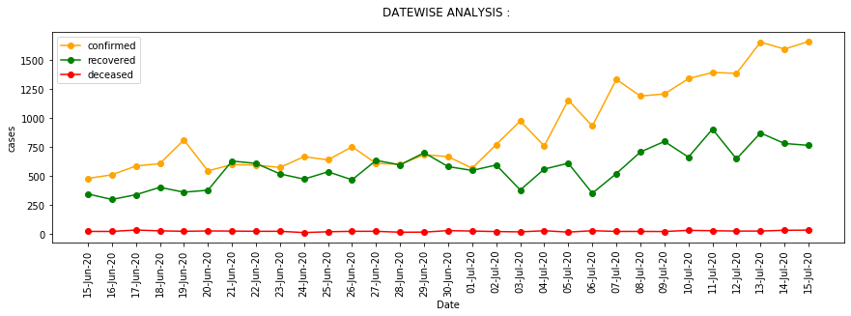
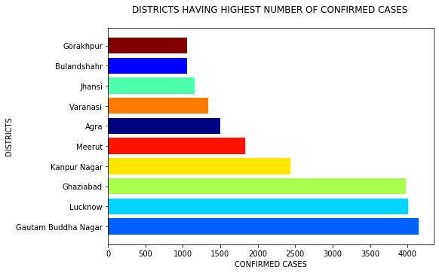
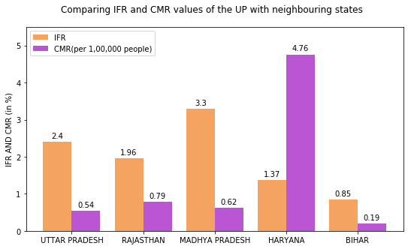
Uttar Pradesh COVID-19 DASHBOARD for Honourable Chief Minister

Slide 3
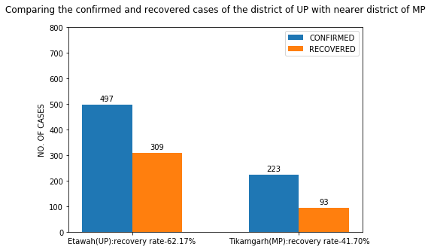
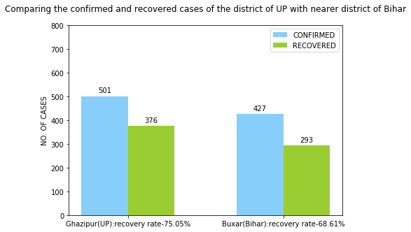
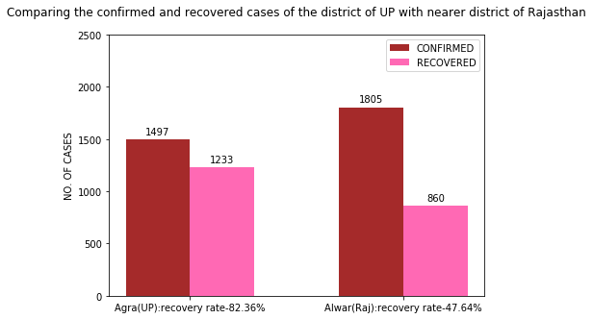
Uttar Pradesh COVID-19 DASHBOARD for Honourable Chief Minister
THANK YOU

